Slide 1

Spotify Redesign
Enhancing User Experience through HCI Principles.

Slide 2
Team members
Name | Section
Adel Yasser Abdelwahab Ebied | C3
Helal Ashraf Helal Abdallah Elgamal | C5
Ahmed Abdelhakim Mohammed Abdelaliem Lokma | C1

Slide 3
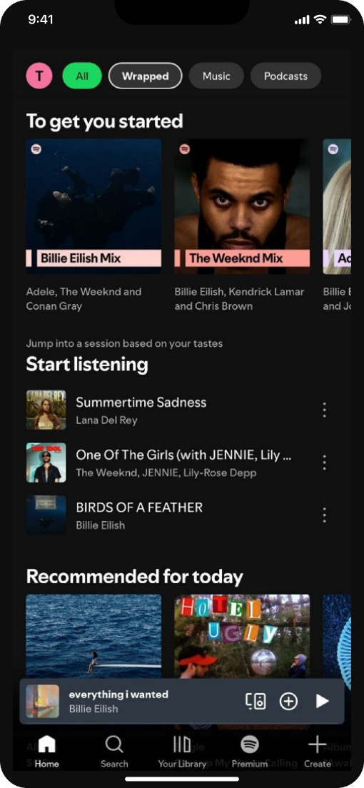
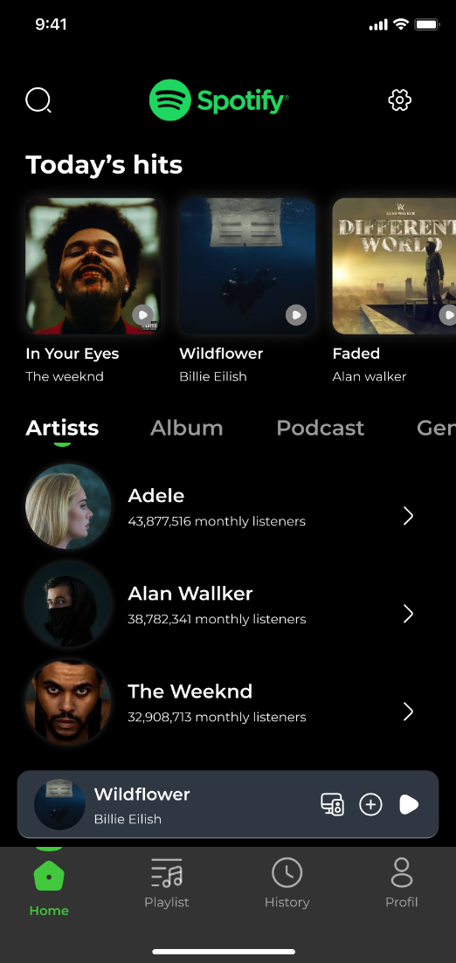
Home Screen
Problem:
The old bottom navigation had "Premium" and "Create," which are business goals, not user goals.
The layout was cluttered with small text.
Solution:
Simplified Navigation: You changed the bottom bar to Home, Playlist, History, Profile. This prioritizes User Frequency (users check history more than they buy premium).
Carousel Cards: You used large, swipeable cards for "Today's Hits" instead of a crowded list.
HCI Principle:
Match between System and Real World: The new "History" tab mimics how people naturally recall past events, rather than forcing them to search.
Old Design
New Design

Slide 4
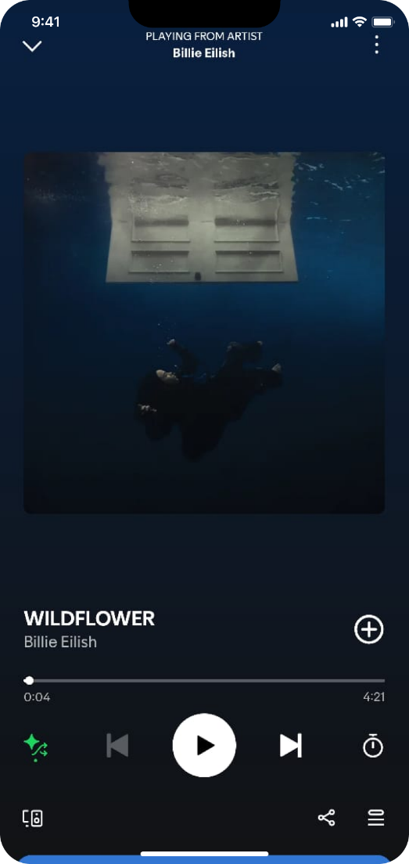
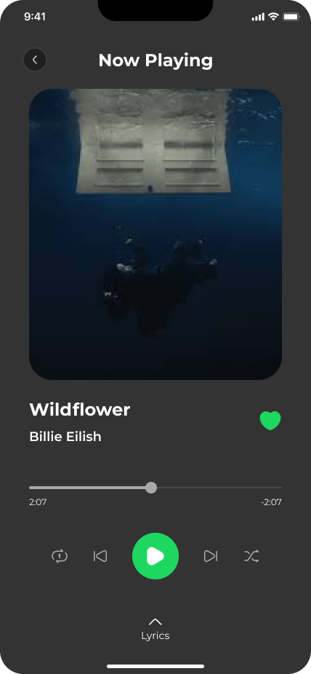
Now Playing
Problem:
The "Play" button was white and the same size as other controls. The background color (blue) reduced text contrast.
Solution:
The Green Button: You made the Play button Green, Solid, and Larger.
Contrast Fix: You switched to a dark gray background, making the white text much easier to read.
HCI Principle:
Fitts’s Law The primary action (Play) is now the largest and most distinct target, reducing the time it takes to hit it.
Old Design
New Design

Slide 5
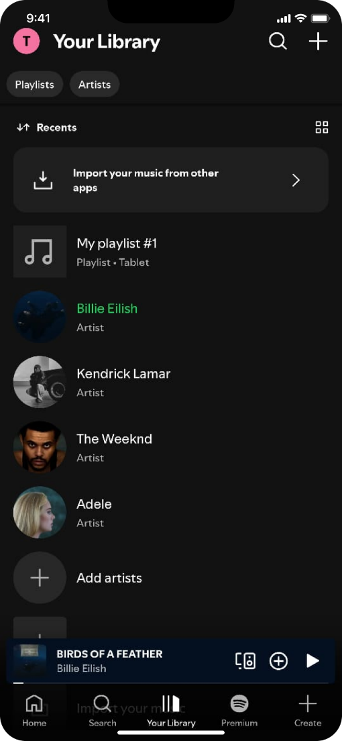
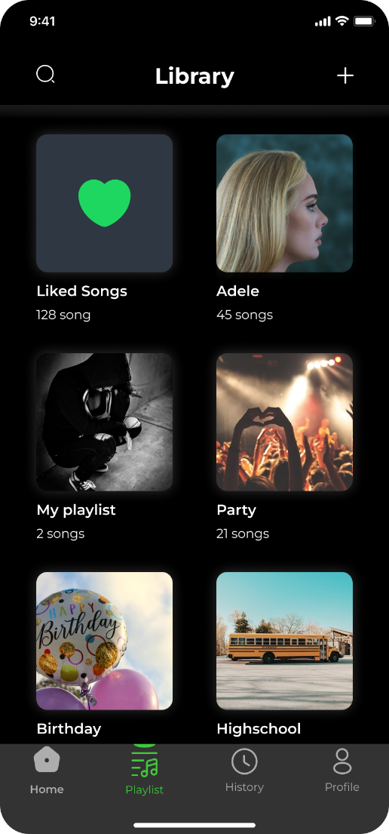
Library
Problem:
High Cognitive Load: The layout used a vertical, text-heavy list. Users had to read each line to find their music, which is slow and tiring.
Small Interaction Targets: The rows are thin. According to Fitts’s Law, small targets are harder and slower to hit, especially when the user is moving or using one hand.
Aesthetic Clutter: The list view feels "crowded" and doesn't allow the user to quickly scan for visual landmarks (like album art).
Solution:
Grid-Based Card Layout: Replaced the list with large Visual Cards. This allows users to find their music using images (Album Art) instead of reading text.
Increased Target Area: Each card is a large, square touch target. This makes it much easier for the thumb to tap the correct playlist accurately.
Visual Hierarchy: The most important playlists (like "Liked Songs") are given more visual weight at the top, helping the user focus on their primary goals
Old Design
New Design

Slide 6
Library
HCI Principles:
Recognition over Recall (Cognitive System): Humans recognize images faster than they recall or read text. By using large album covers, the design allows for Visual Recognition, which is much faster than reading a list.
Fitts’s Law (Motor System): Ttime to acquire a target depends on its size. By turning thin rows into large grid cards, you have increased the target size, making the interaction faster and reducing "miss-taps" (Efficiency).
Aesthetic & Minimalist Design: This design reduces "visual noise." It hides less-used text details and emphasizes the visual elements the user cares about most.
Old Design
New Design

Slide 7
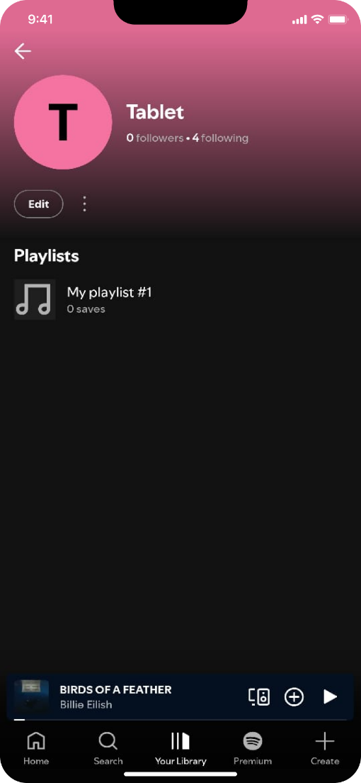
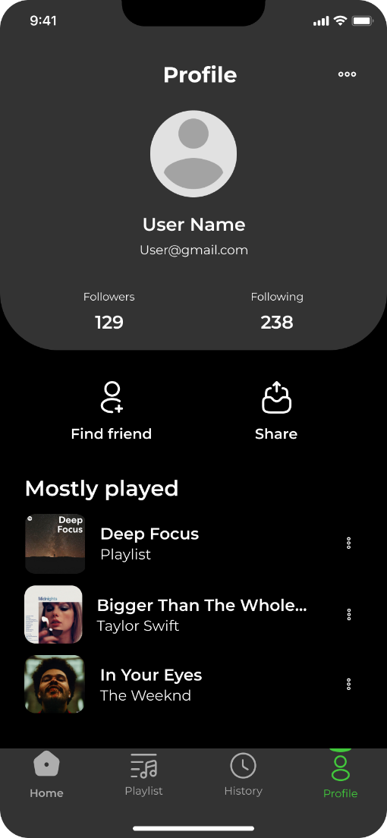
Profile & Social
Problem:
Accessibility Risk: The interface used a dynamic background sampled from the user’s profile image. While visually interesting, this creates unpredictable contrast levels; for instance, white text like "0 followers" becomes difficult to read against lighter image samples
Navigation Friction: Primary social actions were limited to a small, low-priority "Edit" button and a triple-dot menu, making it harder for users to engage with their network
Solution:
Optimized Interactive Targets: I replaced the small "Edit" button with two prominent, high-visibility actions: "Find friend" and "Share". These use large, clear icons to reduce the user's search time.
Enhanced Information Architecture: I improved the visibility of user metrics by placing "Followers" and "Following" counts in a dedicated high-contrast section with increased spacing.
Visual Hierarchy: The redesign introduces a "Mostly played" section with clear list-view thumbnails, allowing for a faster overview of user activity
HCI Principle:
Nielsen’s 8th Heuristic (Aesthetic & Minimalist Design): By moving away from the distracting dynamic gradient to a structured dark theme, the design focuses strictly on relevant user data.
Recognition over Recall: The addition of the "Mostly played" list allows users to instantly recognize their frequent content rather than having to navigate back to the library to find it.
Old Design
New Design

Slide 8
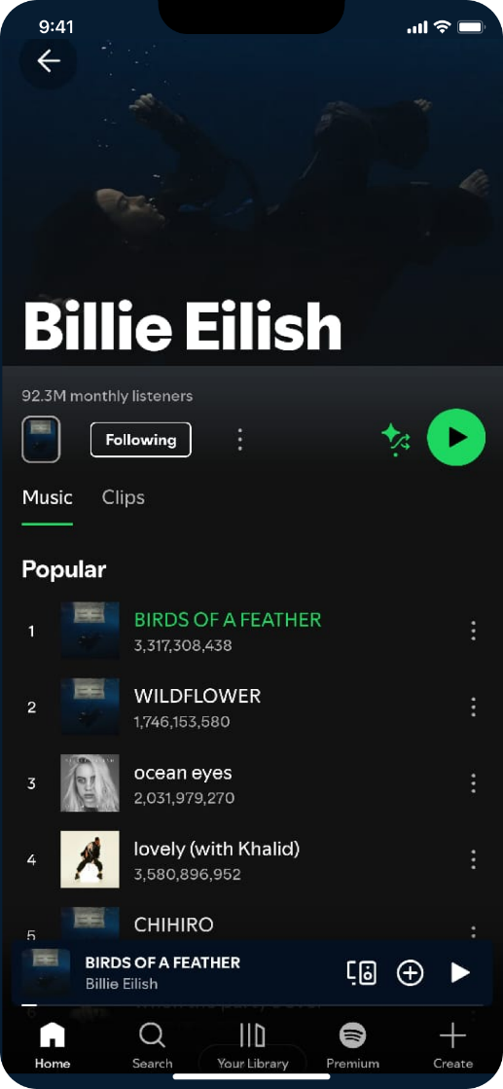
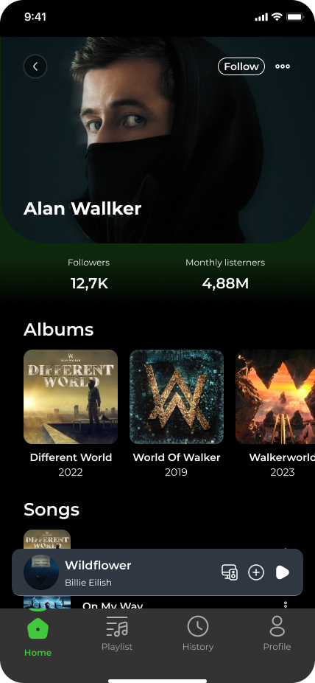
Artist Page
Problem:
Cluttered Interaction Zone: The old layout grouped the "Following" status, play button, and shuffle icon in a tight, disorganized cluster, making it difficult to distinguish primary actions.
Flat Information Architecture: Popular songs were presented as a simple list with very small metadata, leading to high visual scanning effort.
Solution:
Clear Metric Visibility: I introduced a dedicated section for "Followers" and "Monthly listeners" with large, bold typography for immediate data recognition.
Horizontal "Albums" Carousel: I transitioned from lists to high-resolution card thumbnails for albums, allowing for faster visual browsing.
Consistent Navigation: I integrated the new bottom navigation bar (Home, Playlist, History, Profile) to ensure a consistent user path.
HCI Principle: (Visual Hierarchy)
By using size and spacing to separate "Artist Stats" from "Content Categories," we guide the user's eye to the most relevant information first.
Old Design
New Design

Slide 9
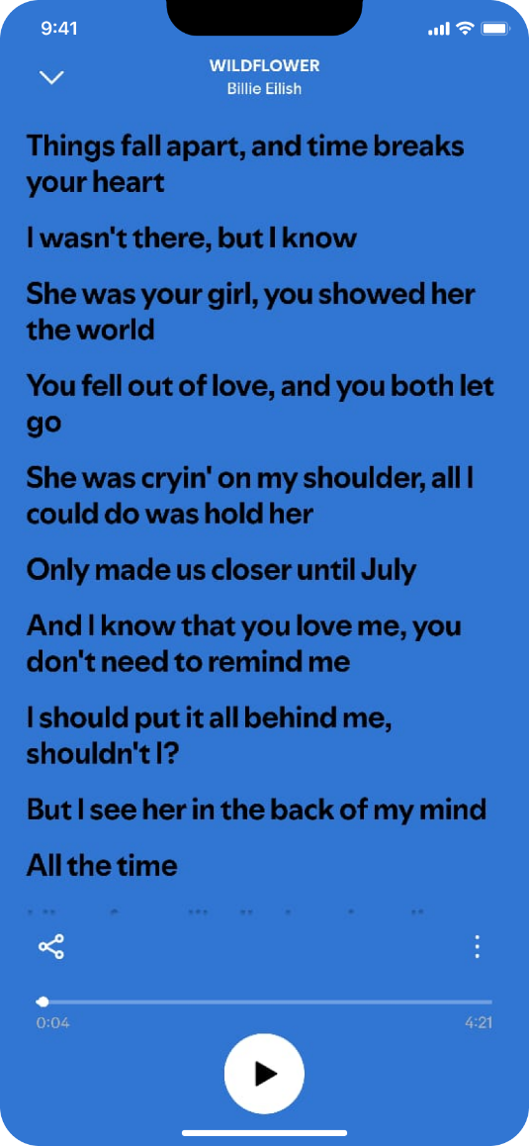
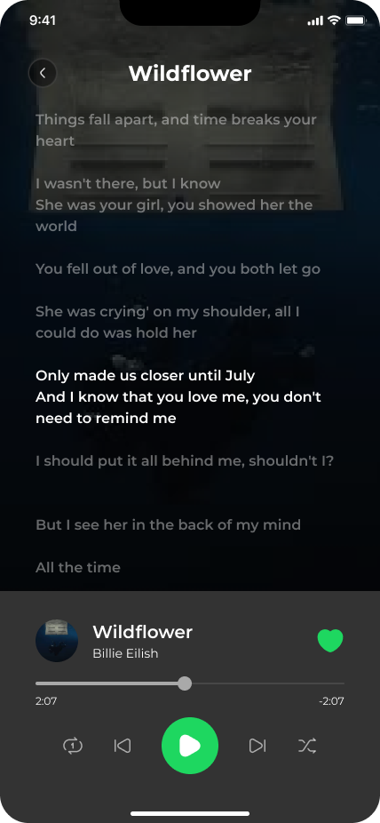
The Lyrics Page
Problem:
Lack of Context: The old lyrics view filled the entire screen, hiding the playback controls and making it difficult for users to skip tracks or see song progress while reading.
Low Contrast: Text was displayed against a flat blue background without an "Active State" highlight for the current line being sung.
Solution:
Hybrid Layout: I introduced a persistent "Control Card" at the bottom of the lyrics view, so users never lose access to Play/Pause, Skip, or the Progress Bar.
Active State Highlighting: The current lyric line is now high-contrast white, while upcoming lines are dimmed to 50% opacity.
HCI Principle: (Visibility of System Status)
The design now provides constant feedback on the "Current Line" and "Current Playback Progress," ensuring the user is never confused about the system state.
Old Design
New Design

Slide 10
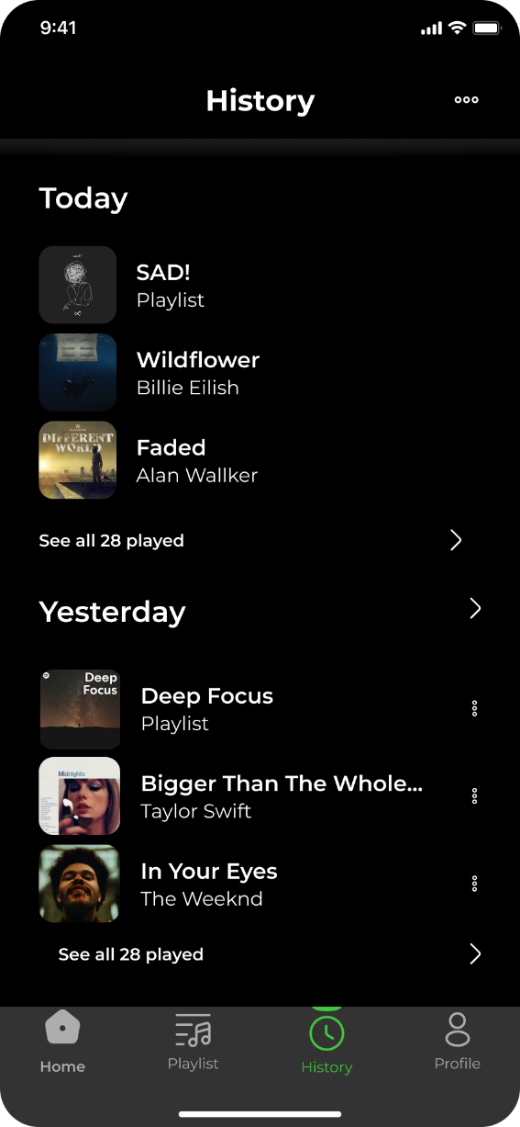
History Feature (New Addition)
Why?
The History Page was added to transition the user experience from Active Retrieval (Search) to Passive Recognition (History), significantly lowering the mental effort required to re-engage with past content
HCI Principle: (Recognition rather than Recall)
Users shouldn't have to remember (recall) the song they listened to yesterday; the system should show (recognize) it to them.

Slide 11
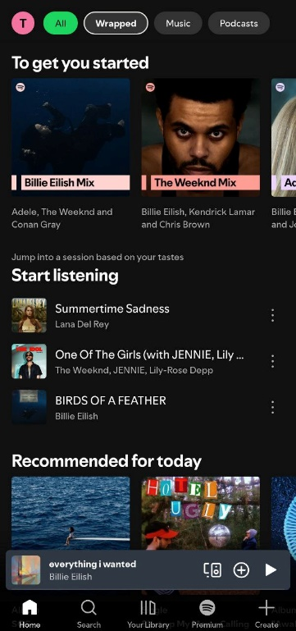
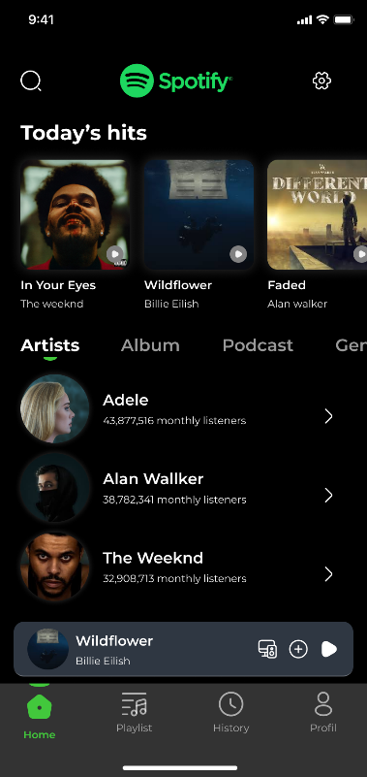
Conclusion
How we improve the Design
Optimized Mobile Ergonomics (Fitts’s Law): By enlarging the primary playback controls and moving them into the natural "Thumb Zone," the design significantly reduces physical effort and prevents accidental "miss-taps" during one-handed use.
Reduced Cognitive Load (Recognition over Recall): Replacing dense text lists with a colorful, high-contrast playlist grid and a dedicated "History" tab allows users to find their music instantly through visual recognition rather than mental recall.
Improved Accessibility (WCAG Compliance): The transition to a structured dark theme with high-contrast typography ensures that all metadata and action buttons remain readable for all users, regardless of dynamic background colors or environmental lighting.

Slide 12
Thanks ☺

